Slide 1
Language Implementation Methods

Slide 2
Implementation Methods
Compilation
  Programs are translated into machine language; includes JIT systems
  Use: Large commercial applications
Pure Interpretation
  Programs are interpreted by another program known as an interpreter
  Use: Small programs or when efficiency is not an issue
Hybrid Implementation Systems
  A compromise between compilers and pure interpreters
  Use: Small and medium systems when efficiency is not the first concern

Slide 3
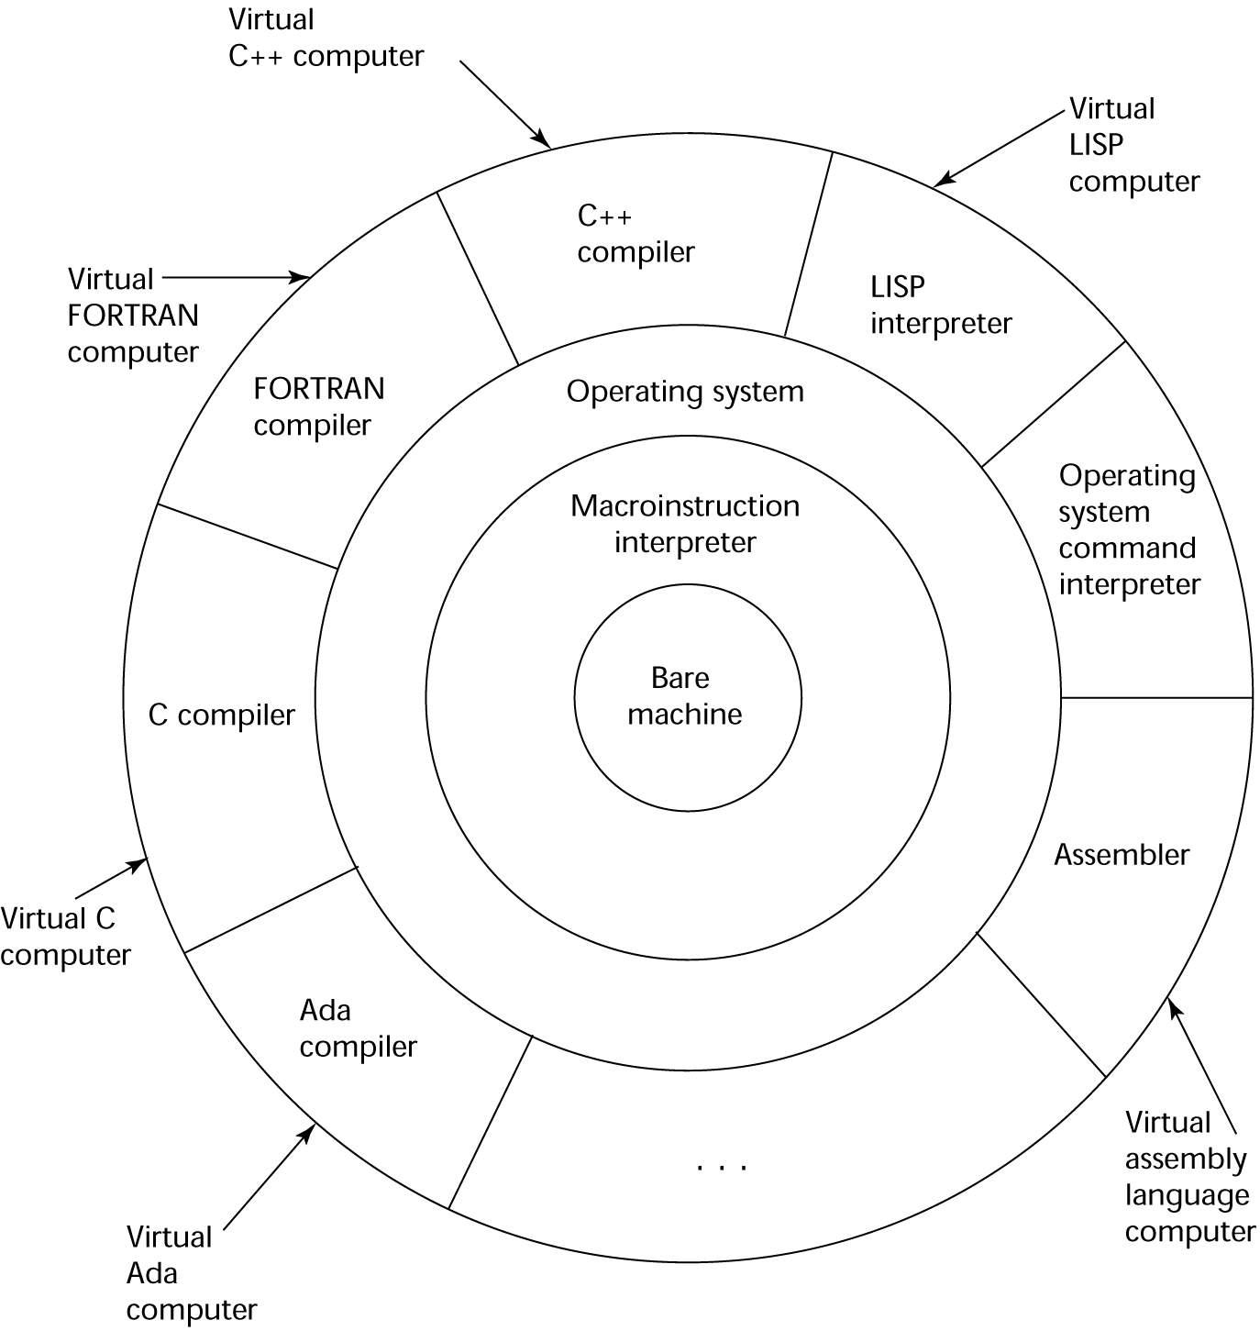
Layered View of Computer
The operating system and language implementation are layered over
machine interface of a computer

Slide 4
Compilation
Translate high-level program (source language) into machine code (machine language)
Slow translation, fast execution
Compilation process has several phases:
  lexical analysis: converts characters in the source program into lexical units
  syntax analysis: transforms lexical units into parse trees which represent the syntactic structure of program
  Semantics analysis: generate intermediate code
  code generation: machine code is generated

Slide 5
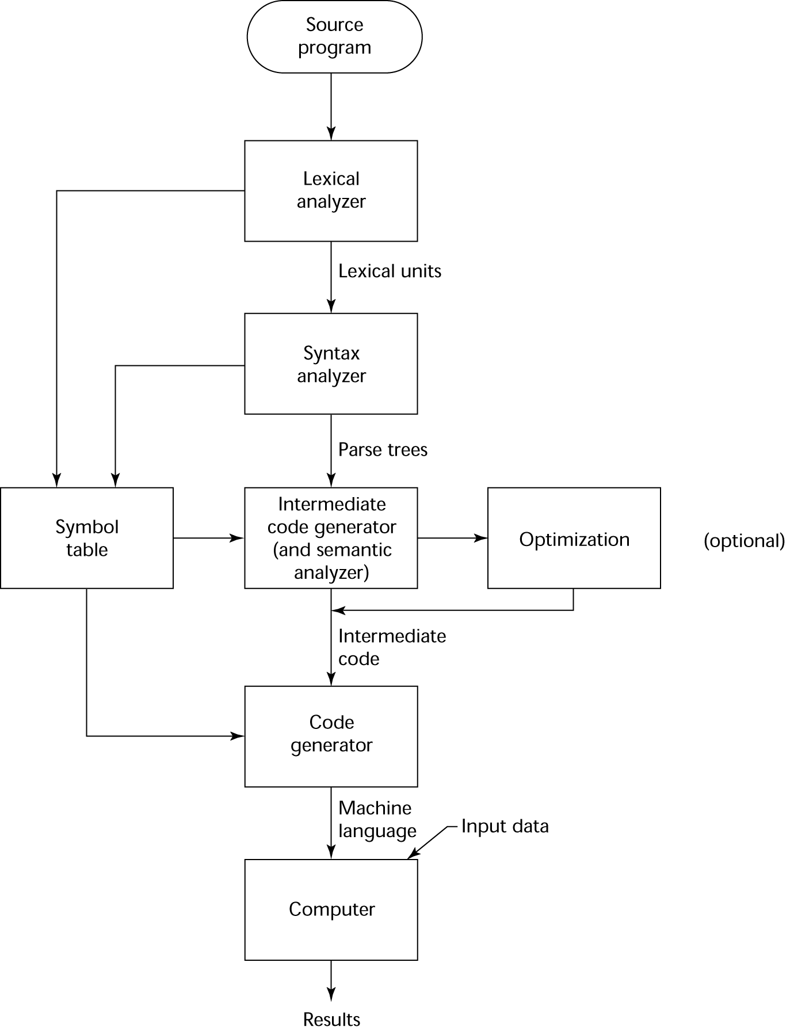
The Compilation Process

Slide 6
Additional Compilation Terminologies
Load module (executable image): the user and system code together
Linking and loading: the process of collecting system program units and linking them to a user program

Slide 7
Von Neumann Bottleneck
Connection speed between a computer’s memory and its processor determines the speed of a computer
Program instructions often can be executed much faster than the speed of the connection; the connection speed thus results in a bottleneck
Known as the von Neumann bottleneck; it is the primary limiting factor in the speed of computers

Slide 8
Pure Interpretation
No translation
Easier implementation of programs (run-time errors can easily and immediately be displayed)
Slower execution (10 to 100 times slower than compiled programs)
Often requires more space
Now rare for traditional high-level languages
Significant comeback with some Web scripting languages (e.g., JavaScript, PHP)

Slide 9
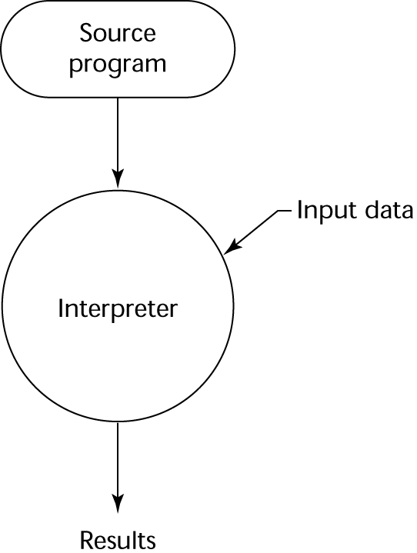
Pure Interpretation Process

Slide 10
Hybrid Implementation Systems
A compromise between compilers and pure interpreters
A high-level language program is translated to an intermediate language that allows easy interpretation
Faster than pure interpretation
Examples
  Perl programs are partially compiled to detect errors before interpretation
  Initial implementations of Java were hybrid; the intermediate form, byte code, provides portability to any machine that has a byte code interpreter and a run-time system (together, these are called Java Virtual Machine)

Slide 11
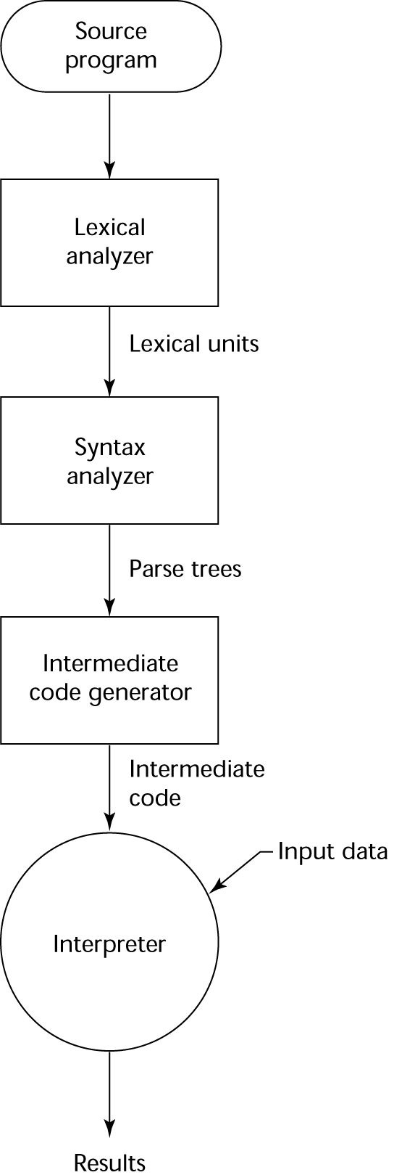
Hybrid Implementation Process

Slide 12
Just-in-Time Implementation Systems
Initially translate programs to an intermediate language
Then compile the intermediate language of the subprograms into machine code when they are called
Machine code version is kept for subsequent calls
JIT systems are widely used for Java programs
.NET languages are implemented with a JIT system
In essence, JIT systems are delayed compilers

Slide 13
Preprocessors
Preprocessor macros (instructions) are commonly used to specify that code from another file is to be included
A preprocessor processes a program immediately before the program is compiled to expand embedded preprocessor macros
A well-known example: C preprocessor
  expands #include, #define, and similar macros

Slide 14
Programming Environments
A collection of tools used in software development
UNIX
  An older operating system and tool collection
  Nowadays often used through a GUI (e.g., CDE, KDE, or GNOME) that runs on top of UNIX
Microsoft Visual Studio.NET
  A large, complex visual environment
Used to build Web applications and non-Web applications in any .NET language
NetBeans
  Related to Visual Studio .NET, except for applications in Java

Slide 15
Summary
The study of programming languages is valuable for a number of reasons:
  Increase our capacity to use different constructs
  Enable us to choose languages more intelligently
  Makes learning new languages easier
Most important criteria for evaluating programming languages include:
  Readability, writability, reliability, cost
Major influences on language design have been machine architecture and software development methodologies
The major methods of implementing programming languages are: compilation, pure interpretation, and hybrid implementation

